Slide 1
8.3 Covalent Bonding
Honors Chem - 2019

Slide 2
8.3 Covalent Bonding
Most compounds that we come into contact with during the course of the day do not exhibit qualities of ionic solids
They are typically solids, liquids, and gases with low melting points
Gasoline - vaporizes readily
Plastic - low melting point, not rigid
Water!
Can you name any others?
For a large portion of substances, we need a different bonding model

Slide 3
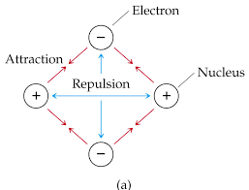
8.3 Covalent Bonding
Hydrogen, and its lewis structure represent the simplest form of a covalent molecule
Which is an interesting concept…
Nuclei repulse each other…
Electrons repulse each other…
Yet molecules stay together…
Certainly attractive forces must exceed the repulsive ones

Slide 4
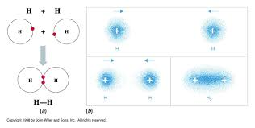
8.3 Covalent Bonding
Quantum mechanical models tell us that…
The electron density is concentrated between the nuclei..
There is a net overall attraction to the electron pair that exists primarily between the two hydrogen atoms
Attraction to that pair is the “glue” that keeps these molecules together
More on this in chapter 9

Slide 5
8.3 Lewis Structures
This is the fun part (drawing Lewis structures)
Seems basic but it is INCREDIBLY USEFUL across many disciplines
Covalent structures can be represented using Lewis symbols
The formation of the H2 molecule from 2 hydrogen atoms can be represented like the drawing shown to the right
H2 Lewis Structure

Slide 6
8.3 Lewis Structures
Lewis structures - shown using dot diagrams how many and where the electron sharing occurs between 2 elements
Shared electron pairs are shown with a line
Since the number of valence electrons in neutral atoms (especially nonmetals) can be determined by their group…
We can also determine how many bonds they will form…
Fluorine - 1
Oxygen - 2
Nitrogen - 3
Single Bond - 1 shared electron pair

Slide 7
8.3 Lewis Structures
Tips:
This exercise takes some practice, write in pencil be prepared to erase, there is some trial and error
The central atom is typically the least electronegative element (that is not hydrogen) but not always
Attempt to draw the electrons so that each bonded element fulfills its octet…
Keeping in mind, hydrogen is an exception (only needs 2)
May help to circle the octets…

Slide 8
8.3 Lewis Structures with Single Bonds
Let’s practice
HF
H2O
NH3
CH4

Slide 9
8.3 Lewis Structure with Multiple Bonds
Single Bond - sharing of a single pair
Double Bond - sharing of two pairs of electrons to fulfill an octet
Triple bond - sharing of three pair of electrons

Slide 10
8.3 Lewis Structure with Multiple Bonds
Practice with multiple bonds
N2
CO2
O2
C2H4

Slide 11
8.3 Bond Length and Strength
Triple bond in nitrogen is proof of its properties
N2 is a very stable, unreactive gas
Double and Triple bonds are generally stronger than single bonds
Double and Triple bonds are generally shorter than that of single bonds

Slide 12
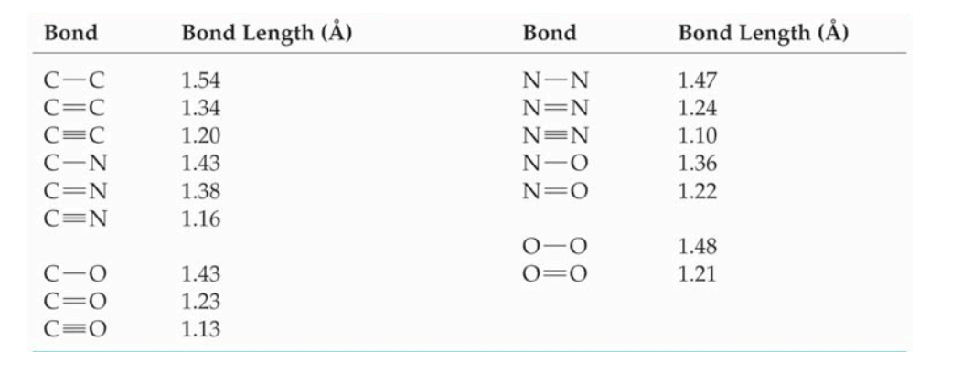
8.3 Bond Length and Strength
Notice the differences in bond length

